Slide 1

MOBILE APP DEVELOPMENT PROCESS
PRESENTED BY: GROUP 11
Supervised By: Dr Nkemeni Valery

Slide 2
Name | Matricule
FUNWI KELSEA NDOHNWI | FE23A066
NGADANG ASSONFACK P. ESTELLE | FE23A109
ATEH SWIRRI FOFANG | FE23A018
TABOT GHISLAIN OROCK | FE23A146

Slide 3
INTRODUCTION TO MOBILE APPS
Mobile applications are software programs developed to run on mobile devices such as smartphones and tablets.
Classified Based On
Development method: This refers to how the app is built.
Platform compatibility: This means which devices or operating systems the app can run on.
Hardware accessibility : This refers to how much of the phone’s hardware the app can use.
Performance Level: This describes how fast, smooth, and efficient the app is.

Slide 4
Types of Mobile Applications (5)
⁠Native Apps
Web Apps
⁠Hybrid Apps
Cross-Platform Apps
Cross-Platform Apps
⁠ ⁠Native Apps
- Built for one platform (Android or iOS)
- Very fast and reliable
- Expensive to develop

Slide 5
1. ⁠ ⁠Native Apps
Built for one platform (Android or iOS)
Very fast and reliable
Expensive to develop

Slide 6
2. ⁠ ⁠ ⁠Web Apps
Run in a browser
No installation needed
Cheap but limited

Slide 7
3. ⁠ ⁠ ⁠Hybrid Apps
- Combination of web and native
- One codebase
- Moderate performance

Slide 8
4. ⁠ ⁠ ⁠Cross-Platform Apps
One app works on multiple platforms
Saves time and cost
Very popular today

Slide 9
5. ⁠ ⁠ ⁠Progressive Web Apps (PWA)
Web apps that act like mobile apps
Can work offline
Lightweight but limited features

Slide 10
Key Comparison of App Types
Native apps offer the best performance and full device access.
Web apps are cheaper and easier to maintain.
Hybrid apps reduce development cost. Cross-platform apps balance cost and performance.
PWA provides lightweight app-like experiences.
The choice depends on:
-Budget
-Performance needs
-Target devices
-User experience

Slide 11
Programming Languages And Frameworks
​Frameworks
- React Native​ (JavaScript / Typescript)
- Flutter​ (Dart )
- Xamarin​ (C#)
iOS Languages
Swift – main modern language
Objective-C – older language
Android Languages
Java – traditional language
Kotlin – official modern language

Slide 12
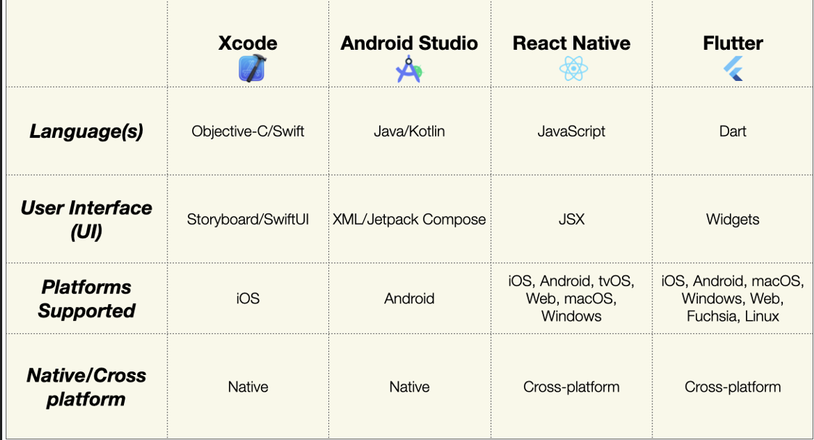
.

Slide 13
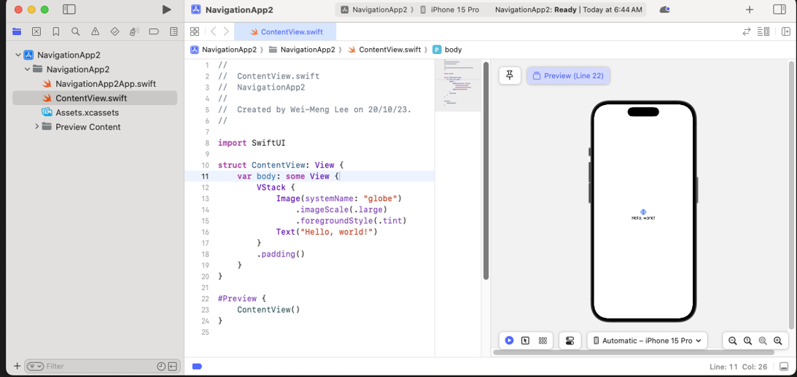
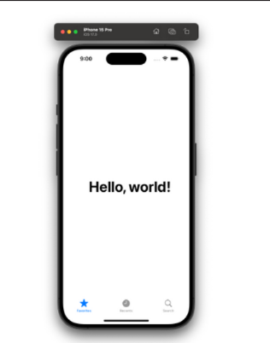
X-CODE (SWIFT)
VHJ

Slide 14
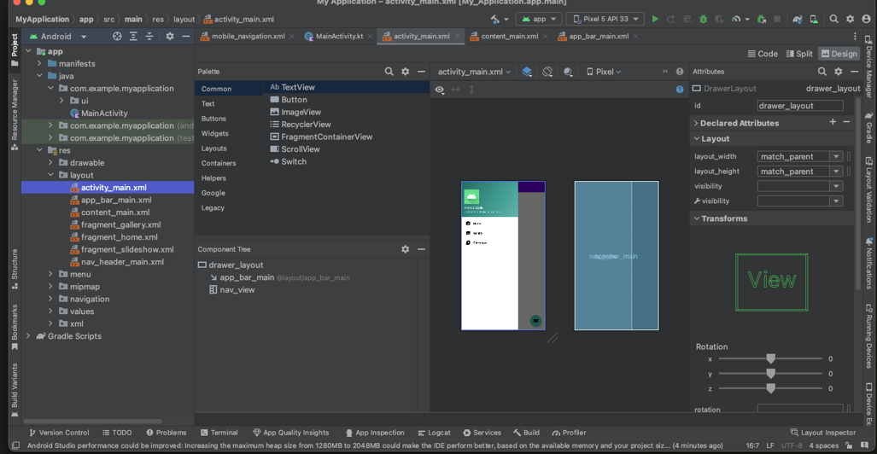
ANDROID STUDIO

Slide 15
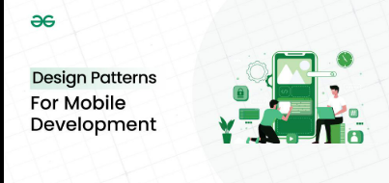
Design patterns are reusable solutions to common software development problems.

Slide 16
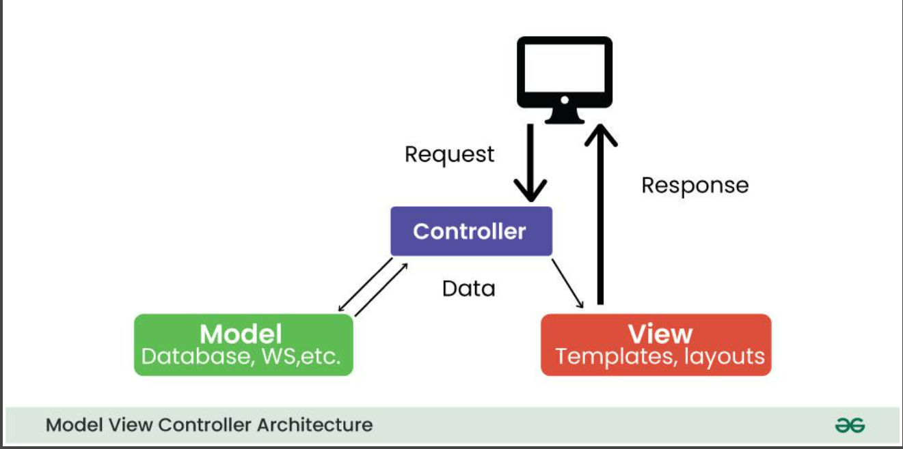
MVC
MVC (Model-View-Controller): The classic separation. Simple but can lead to "MassiveControllers" in big apps.

Slide 17
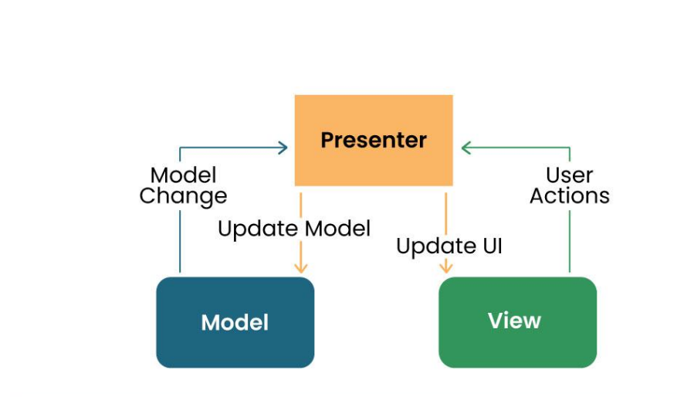
MVP
MVP (Model-View-Presenter): Presenter acts as a middleman; better for unit testing.

Slide 18
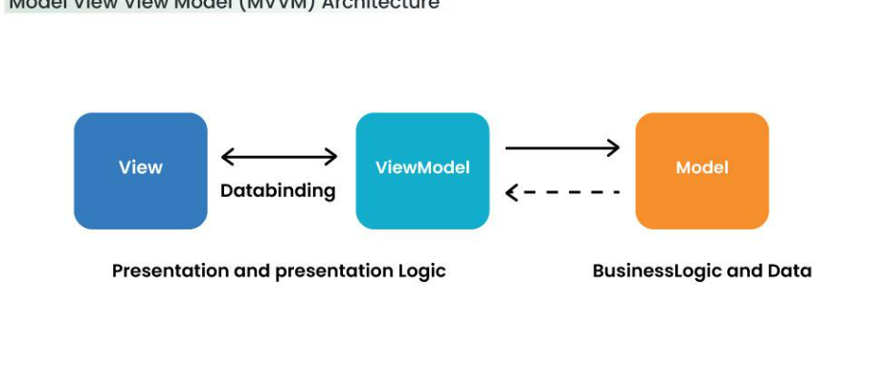
MVVM
MVVM (Model-View-ViewModel): Modern standard (Android Jetpack). Uses Data Binding tosync UI and Logic automatically.

Slide 19
Requirement Engineering (The 5 Stages)
Elicitation: Interviews and user research.
Analysis: Feasibility studies and "Must-have" vs. "Nice-to-have" (MVP).
Specification: Documenting User Stories and Functional requirements.
Validation: Prototyping in Figma before coding.
Management: Handling "Scope Creep" and change requests.

Slide 20
Cost Estimation in Cameroon (XAF)
Simple/MVP: 300,000 – 500,000 FCFA.
Medium (with Momo/OM): 500,000 – 1,000,000 FCFA.
Complex/Enterprise: 1,000,000+ FCFA.
Key Factors: Number of screens, backend complexity, and third-party integrations.

Slide 21
Conclusion & Key Takeaways
Architecture Over Code: Choosing the right pattern (MVVM/MVP) is the foundation for building scalable, easy-to-maintain applications.
The Cross-Platform Edge: Frameworks like Flutter and React Native provide the ideal balance of performance and cost-efficiency for our local market.
Precision in Planning: Strong Requirement Engineering prevents technical debt and ensures the final product effectively solves the user's problem.

